Slide 1



Restaurant & Consumer Data Project

Slide 2


ABOUT ME
I am Madhu Sudhan from Innomatics Research Labs.
This project uses SQL to analyse restaurant and consumer data.
I created tables from raw CSV files and used joins, subqueries, and CTEs, view and stored procedures to find useful insights.
I analysed ratings, customer behaviour, and restaurant performance using SQL queries.
This project helped me understand how SQL can answer business questions and support better decisions.

Slide 3
AGENDA
Objective of the Project
ER Diagram and schema explanation
Key analysis questions (use cases)
SQL query results with screenshots or summaries
Final business insights and recommendations
Conclusion (Key finding overall)
Your Experience/Challenges working on SQL – Data Analysis Project.

Slide 4
Objective
Restaurants have lots of customer data but don’t know what it really means
Owners can’t easily find out: Who loves my food? Where am I failing? What should I improve?
Important questions stay unanswered because the data is “locked” in tables
This project uses SQL to unlock and analyse the data quickly and correctly
Goal: Give restaurant owners simple, actionable ideas to get more happy customers and earn more money

Slide 5
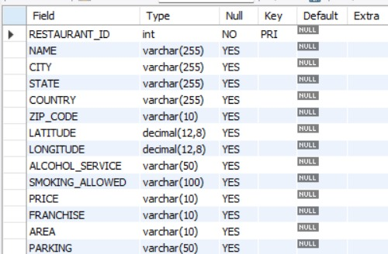
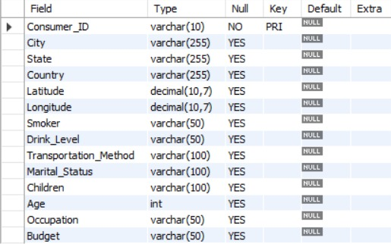
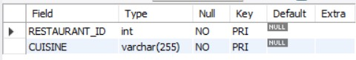
Tables
RESTAURANTS TABLE
CONSUMERS TABLE
RESTAURANT_CUISINES TABLE

Slide 6
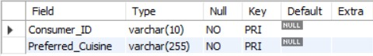
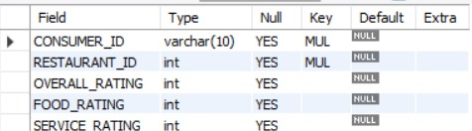
Tables
CONSUMER_PREFERENCES TABLE
RATINGS TABLE

Slide 7
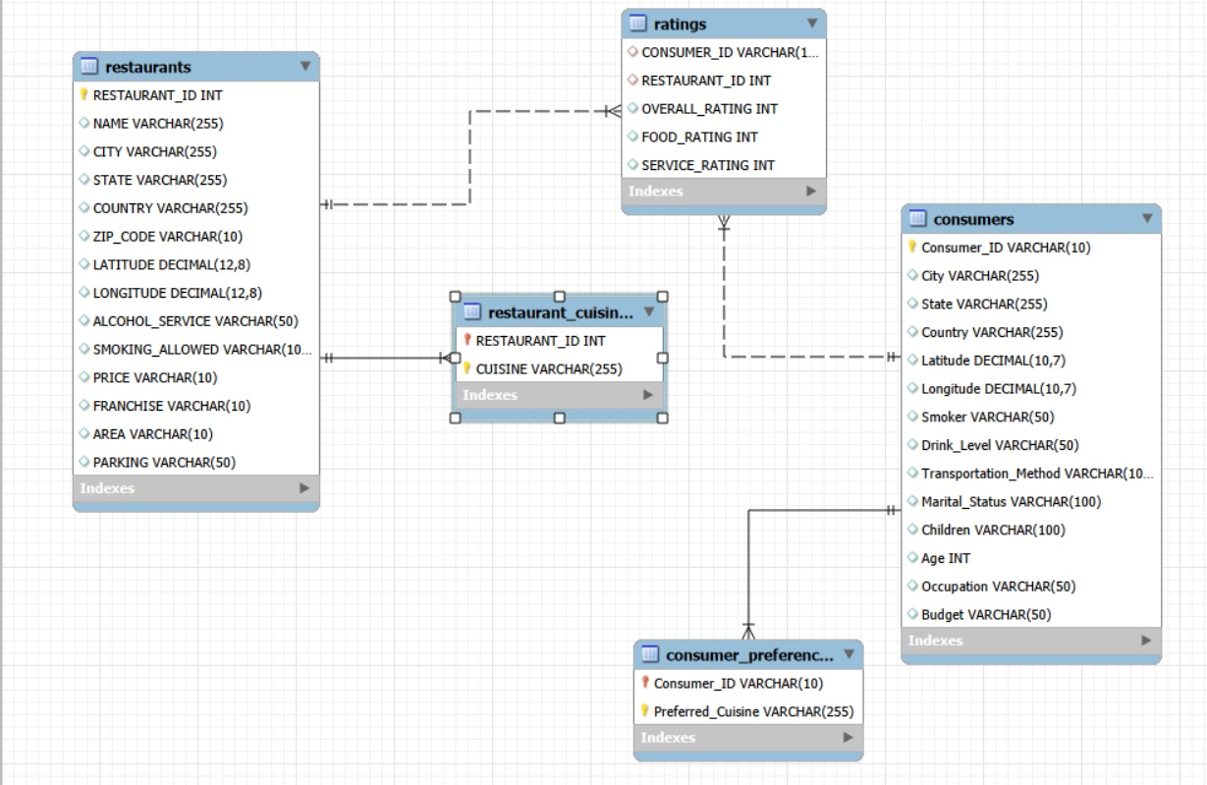
ER Diagram

Slide 8
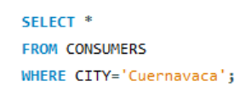
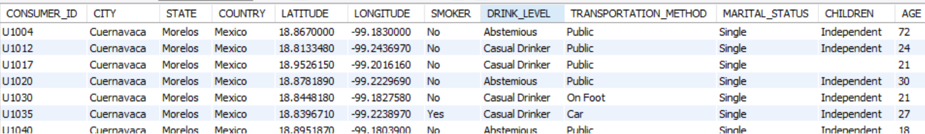
Using the WHERE clause to filter data based on specific criteria.
1. LIST ALL DETAILS OF CONSUMERS WHO LIVE IN THE CITY OF 'CUERNAVACA'.

Slide 9
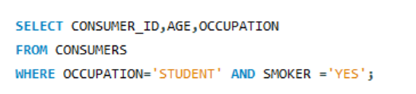
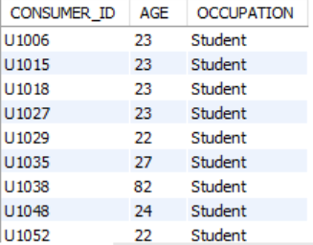
2.Find the Consumer_ID, Age, and Occupation of all consumers who are 'Students' AND are 'Smokers'.

Slide 10
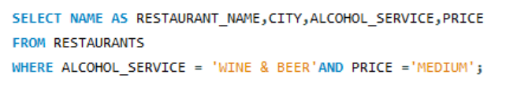
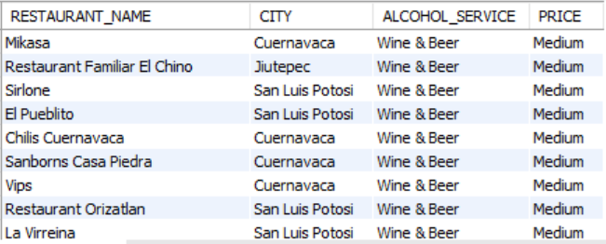
3.List the Name, City, Alcohol_Service, and Price of all restaurants that serve 'Wine & Beer' and have a 'Medium' price level.

Slide 11
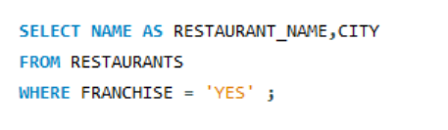
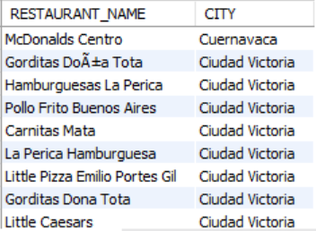
4.Find the names and cities of all restaurants that are part of a 'Franchise'.

Slide 12
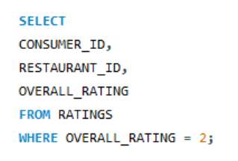
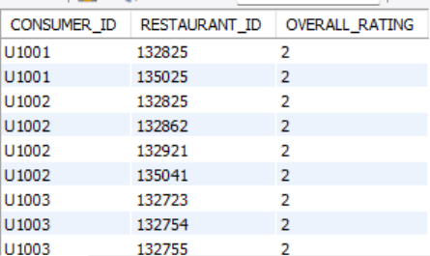
5.Show the Consumer_ID, Restaurant_ID, and Overall_Rating for all ratings where the Overall_Rating was 'Highly Satisfactory' (which corresponds to a value of 2, according to the data dictionary).

Slide 13
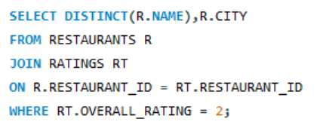
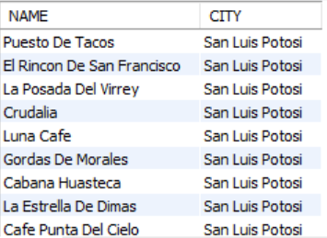
Questions JOINs with Subqueries
1.List the names and cities of all restaurants that have an Overall_Rating of 2 (Highly Satisfactory) from at least one consumer.

Slide 14
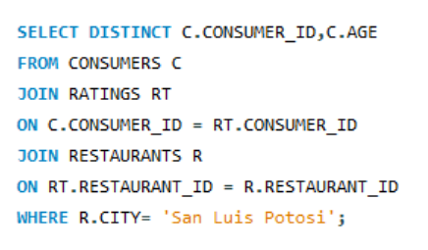
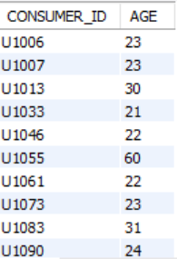
2.Find the Consumer_ID and Age of consumers who have rated restaurants located in 'San Luis Potosi'.

Slide 15
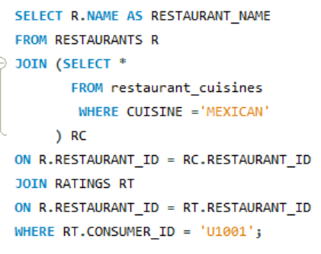
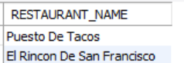
3.List the names of restaurants that serve 'Mexican' cuisine and have been rated by consumer 'U1001'.

Slide 16
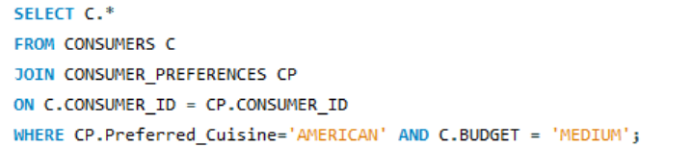
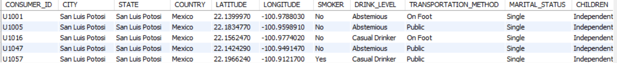
4.Find all details of consumers who prefer 'American' cuisine AND have a 'Medium' budget.

Slide 17
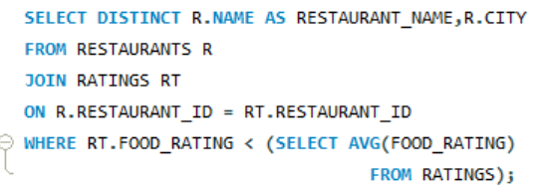
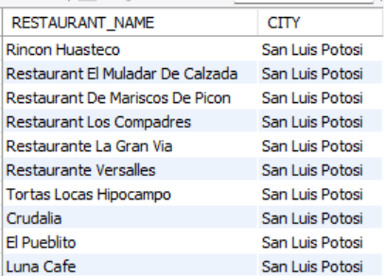
5.List restaurants (Name, City) that have received a Food_Rating lower than the average Food_Rating across all rated restaurants.

Slide 18
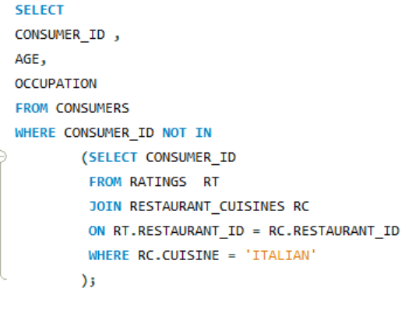
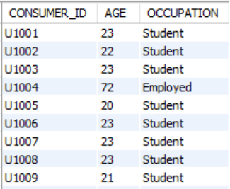
6.Find consumers (Consumer_ID, Age, Occupation) who have rated at least one restaurant but have NOT rated any restaurant that serves 'Italian' cuisine.

Slide 19
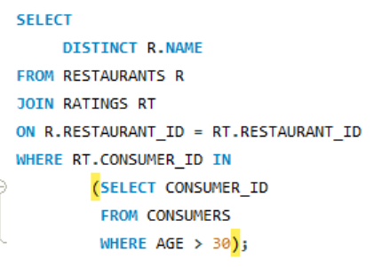
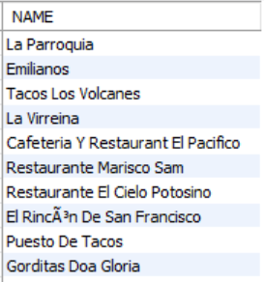
7.List restaurants (Name) that have received ratings from consumers older than 30.

Slide 20
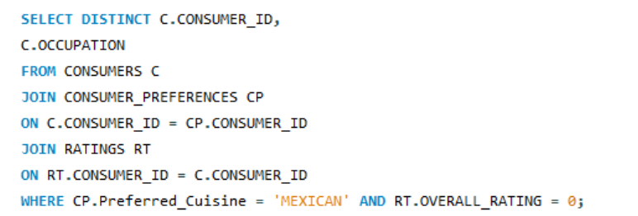
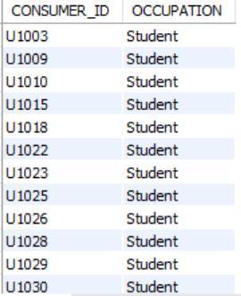
8.Find the Consumer_ID and Occupation of consumers whose preferred cuisine is 'Mexican' and who have given an Overall_Rating of 0 to at least one restaurant (any restaurant).

Slide 21
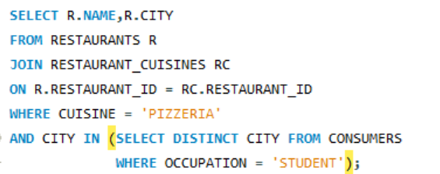
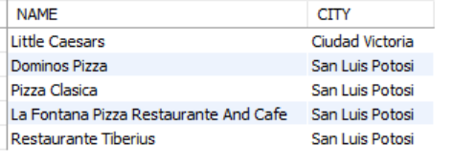
9.List the names and cities of restaurants that serve 'Pizzeria' cuisine and are located in a city where at least one 'Student' consumer lives.

Slide 22
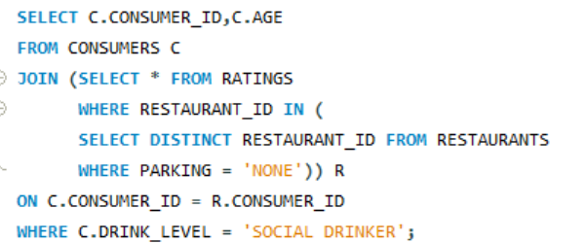
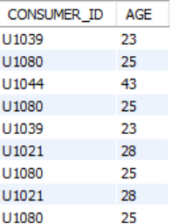
10.Find consumers (Consumer_ID, Age) who are 'Social Drinkers' and have rated a restaurant that has 'No' parking.

Slide 23
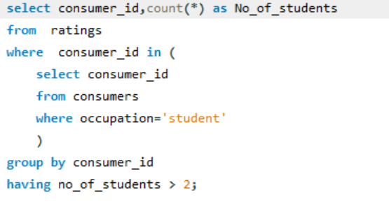
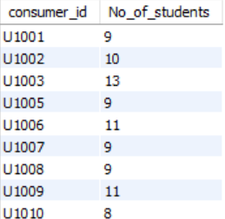
Questions Emphasizing WHERE Clause and Order of Execution
1.List Consumer_IDs and the count of restaurants they've rated, but only for consumers who are 'Students'. Show only students who have rated more than 2 restaurants.

Slide 24
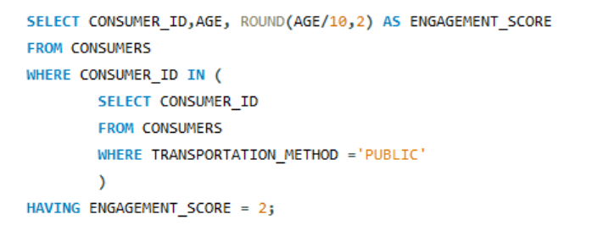
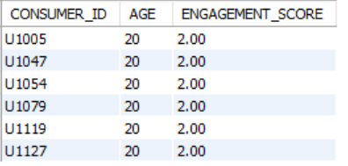
2.We want to categorize consumers by an 'Engagement_Score' which is their Age divided by 10 (integer division). List the Consumer_ID, Age, and this calculated Engagement_Score, but only for consumers whose Engagement_Score would be exactly 2 and who use 'Public' transportation.

Slide 25
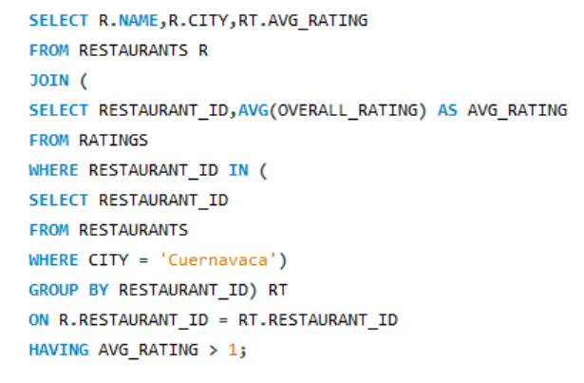
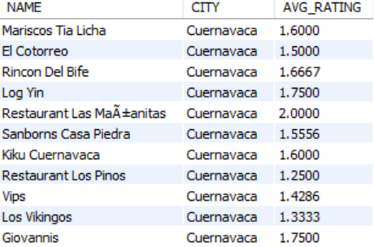
3.For each restaurant, calculate its average Overall_Rating. Then, list the restaurant Name, City, and its calculated average Overall_Rating, but only for restaurants located in 'Cuernavaca' AND whose calculated average Overall_Rating is greater than 1.0.

Slide 26
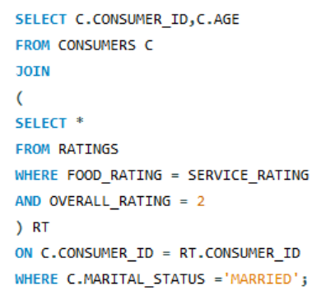
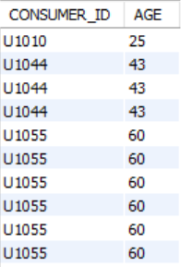
4.Find consumers (Consumer_ID, Age) who are 'Married' and whose Food_Rating for any restaurant is equal to their Service_Rating for that same restaurant, but only consider ratings where the Overall_Rating was 2.

Slide 27
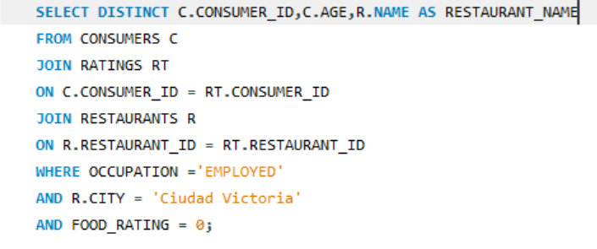
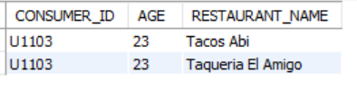
5.List Consumer_ID, Age, and the Name of any restaurant they rated, but only for consumers who are 'Employed' and have given a Food_Rating of 0 to at least one restaurant located in 'Ciudad Victoria'.

Slide 28
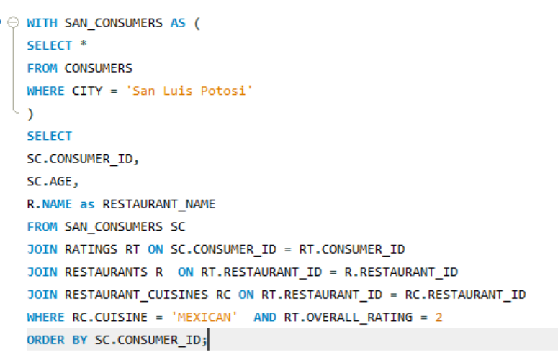
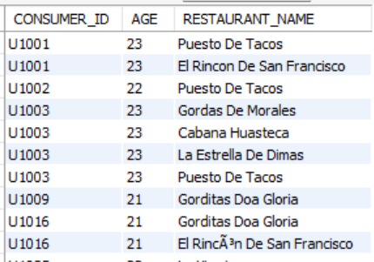
Advanced SQL Concepts: Derived Tables, CTEs, Window Functions, Views, Stored Procedures
1.Using a CTE, find all consumers who live in 'San Luis Potosi'. Then, list their Consumer_ID, Age, and the Name of any Mexican restaurant they have rated with an Overall_Rating of 2.

Slide 29
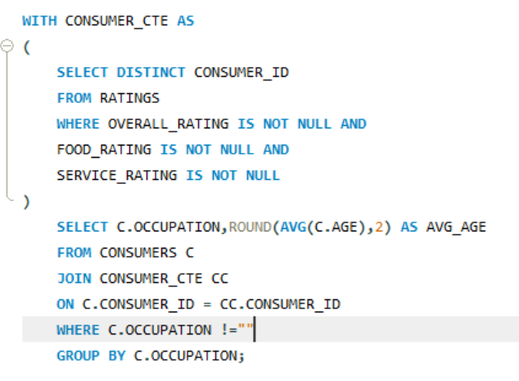
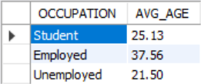
2.For each Occupation, find the average age of consumers. Only consider consumers who have made at least one rating. (Use a derived table to get consumers who have rated).

Slide 30


3.Using a CTE to get all ratings for restaurants in 'Cuernavaca', rank these ratings within each restaurant based on Overall_Rating (highest first). Display Restaurant_ID, Consumer_ID, Overall_Rating, and the Rating Rank.

Slide 31


4.For each rating, show the Consumer_ID, Restaurant_ID, Overall_Rating, and also display the average Overall_Rating given by that specific consumer across all their ratings.

Slide 32


5.Using a CTE, identify students who have a 'Low' budget. Then, for each of these students, list their top 3 most preferred cuisines based on the order they appear in the Consumer_Preferences table (assuming no explicit preference order, use Consumer_ID, Preferred_Cuisine to define order for ROW_NUMBER).

Slide 33


6.Consider all ratings made by 'Consumer_ID' = 'U1008'. For each rating, show the Restaurant_ID, Overall_Rating, and the Overall_Rating of the next restaurant they rated (if any), ordered by Restaurant_ID (as a proxy for time if rating time isn't available). Use a derived table to filter for the consumer's ratings first.

Slide 34


7.Create a VIEW named Highly Rated Mexican Restaurants that shows the Restaurant_ID, Name, and City of all Mexican restaurants that have an average Overall_Rating greater than 1.5.

Slide 35


8.First, ensure the HighlyRatedMexicanRestaurants view from Q7 exists. Then, using a CTE to find consumers who prefer 'Mexican' cuisine, list those consumers (Consumer_ID) who have not rated any restaurant listed in the HighlyRatedMexicanRestaurants view.

Slide 36


9.Create a stored procedure GetRestaurantRatingsAboveThreshold that accepts a Restaurant_ID and a minimum Overall_Rating as input. It should return the Consumer_ID, Overall_Rating, Food_Rating, and Service_Rating for that restaurant where the Overall_Rating meets or exceeds the threshold.

Slide 37


10.Identify the top 2 highest-rated (by Overall_Rating) restaurants for each cuisine type. If there are ties in rating, include all tied restaurants. Display Cuisine, Restaurant_Name, City, and Overall_Rating.

Slide 38


11.First, create a VIEW named ConsumerAverageRatings that lists Consumer_ID and their average Overall_Rating. Then, using this view and a CTE, find the top 5 consumers by their average overall rating. For these top 5 consumers, list their Consumer_ID, their average rating, and the number of 'Mexican' restaurants they have rated.

Slide 39
Final business insights and recommendations
Students are the most active reviewers and love Mexican & Pizzeria food
Cuernavaca gives the highest ratings → medium price + wine & beer = happy customers
Mexican cuisine is the clear #1 in satisfaction across all cities
Franchises/chain restaurants are rated much higher than independent ones
Ciudad Victoria has a serious food-quality problem (many 0 scores)
Italian cuisine is rarely tried by customers
Young social drinkers don’t need parking if the price and vibe are good
Open more franchise (chain) locations – customers love them
Offer student discounts on Mexican & Pizzeria items in Cuernavaca & San Luis Potosí

Slide 40
Conclusion (Key finding overall)
Data-driven decisions powered by strong SQL analysis enable restaurants to boost customer satisfaction, streamline operations, and achieve lasting revenue growth.
Identifying weak performers (low Food_Rating) helps prioritize quality improvement efforts.
Ratings data provides clear signals for service quality, particularly through extreme ratings like 0 or 2.These insights help detect both dissatisfied customers and top-performing restaurants.
Using CTEs, Views, and Stored Procedures ensures reusable and scalable analytics workflows.These SQL techniques improve performance, maintainability, and support dashboard automation.

Slide 41
challenges
Designing efficient Views and Stored Procedures required careful structuring to avoid performance issues.
Complex joins across multiple tables required careful design to avoid duplicates.
Large queries with CTEs and subqueries caused performance slowdowns.
Interpreting business meaning from numeric ratings required careful validation.
Ensuring correct results during multi-level filtering and subquery conditions was challenging.

Slide 42


